Slide 1
Cấu hình cho Bootstrap
1. Trong thẻ head:
<meta charset="utf-8">
<meta name="viewport" content="width=device-width, initial-scale=1">
<link rel="stylesheet" type="text/css" href="../CSS/bootstrap.min.css">
<script src="../JS/jquery.min.js"></script>
<script src="../JS/bootstrap.min.js"></script>
<script src="../JS/BaiCK.js"></script>
<style>
* {
padding: 0px;
margin: 0px auto;
}
li {
width: 150px;
}
</style>

Slide 2
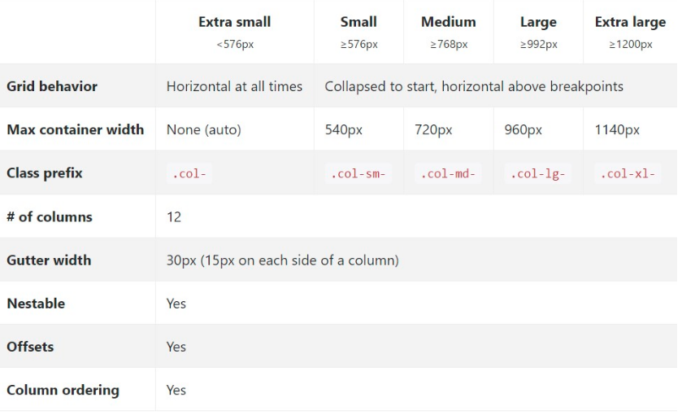
Cấu hình cho Bootstrap

Slide 3
Tạo Layout cho trang
<div class="container-fluid">
<div class="row">
nội dung
</div>
</div>

Slide 4
Tạo header cho trang
2. Tạo header:
<div class="container-fluid">
<div class="row">
<div class="col-md-12">// ảnh chèn chiếm trọng màn hình
<header>
<img src="../Images/Banner.png" width="100%">
</header>
</div>
</div>
</div>

Slide 5
3. Tạo menu:
<div class="col-md-12 col-sm-12">
<nav class="navbar-collapse">
<ul class="navbar-nav nav" style="background-color: #99FFCC;">
<li><a href="#">HOME</a></li>
<li><a href="#">SHOP</a></li>
<li><a href="#">BLOG</a></li>
<li><a href="#">ARTICLE</a></li>
<li class="dropdown">
<a class="dropdown-toggle" data-toggle="dropdown" href="#">SERVICES<span class="caret"></span></a>
<ul class="dropdown-menu">
<li><a href="#" id="myBtn">Online</a></li>
</ul>
</li>
</ul>
</nav>
</div>

Slide 6
4.Tạo table
<div class="row">
<div class="col-md-12">
<section class="col-md-5">
<img src="../Images/left.png" width="100%">
</section>
<aside class="col-md-7" class="table-responsive">
<h2 class="text-danger">Customer Ordered List</h2>
<table class="table table-bordered table-hover">
<tr>
<th>#</th>
<th>Name</th>
<th>Address</th>
<th>Delivery </th>
<th>Email</th>
<th>Telephone number</th>
</tr>
</table>
</aside>
</div>
</div>

Slide 7
5. Tạo Modal
<div class="modal fade" role="dialog" id="myModal">
<div class="modal-dialog">
<div class="modal-content">
<div class="modal-header">
<button type="button“ class="close" data-dismiss="modal">&times;</button>
<h2 class="text-danger">Customer infomation</h2>
</div>
<div class="modal-body">
<form role="form-control" class="form-horizontal">
<div id="thongbao" class="text-danger"></div>
</form>
NỘI DUNG BODY MODAL
</div>
</div>
</div>

Slide 8
5. Tạo Modal
NỘI DUNG BODY MODAL:
<form class="form-group">
<label for="txtTen" class="control-label col-md-3">Customer Name</label>
<div class="col-md-12">
<input type="text" class="form-control" id="txtTen">
<span id="tbTen" class="text-danger">*</span>
</div>
</form>
<form class="form-group">
<label for="txtDC" class="control-label col-xs-3">Address</label>
<div class="col-md-12">
<input type="text" class="form-control" id="txtDC">
<span id="tbDC" class="text-danger">*</span>
</div>
</form>

